Slide 1
Infrared Communication: Short-Range Wireless Technology
Presented by:
Abdus Salam
IT-21016
Department of Information and Communication Technology
Mawlana Bhashani Science & Technology University
Santosh,Tangail-1902.

Slide 2
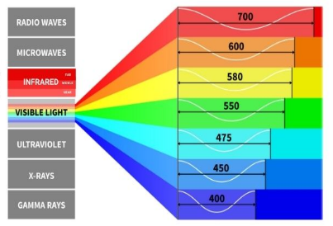
Introduction
• Infrared means 'below red' in the electro-magnetic spectrum.
• Wavelength: 700 nm to 1 mm.
• Used in short-range, line-of- sight communication.
• Example: TV and air conditioner remotes.
• Developed as a low-cost wireless alternative.

Slide 3
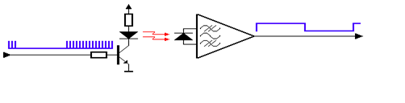
Basic Principle
Communication through infrared light waves.
Transmitter: Infrared LED.
Receiver: Photo-diode or phototransistor.
Data is sent as light pulses representing binary data.
Requires direct line-of-sight between devices.

Slide 4
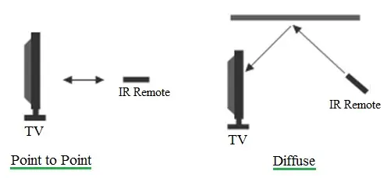
Types of Infrared Communication
1. Point-to-Point: Direct between two devices (e.g., remote and TV).
2. Diffuse: Signals reflected from walls or ceilings.
3. Ir-DA Standard: High-speed data exchange between laptops or phones(old tech).

Slide 5
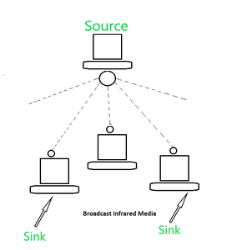
Characteristics
Range: 1 to 5 meters.
Requires clear line-of-sight.
Highly directional signals.
Low power consumption.
Data rate: Up to 16 Mbps (IrDA standard).
Free from radio interference.

Slide 6
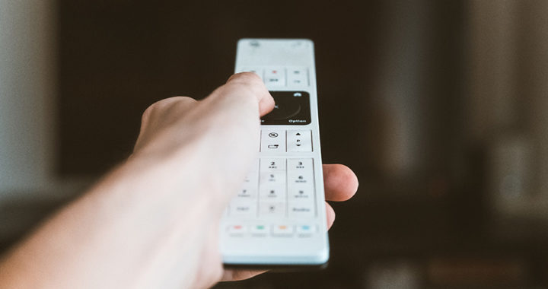
Advantages
Low cost and easy to implement.
High security cannot penetrate walls.
Low power usage battery friendly.
No interference from radio signals.
Simple and reliable technology.

Slide 7
Disadvantages
Short communication range (1–5 meters).
Requires line-of-sight-blocked by obstacles.
Affected by sunlight or bright indoor lights.
Slower data rate compared to Wi-Fi or Bluetooth.

Slide 8
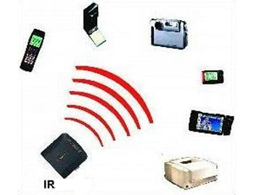
Applications
Remote controls: TVs, AC, projectors.
Wireless data transfer (older devices with Ir-DA).
Sensors: Motion detectors, automatic doors.
Security systems: Intrusion detection.
Industrial and medical instruments.

Slide 9
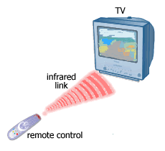
Example – TV Remote
1. Button pressed → circuit generates binary code.
2. IR LED sends modulated light pulses.
3. TV receiver detects and decodes signal.
4. TV performs the desired action.

Slide 10
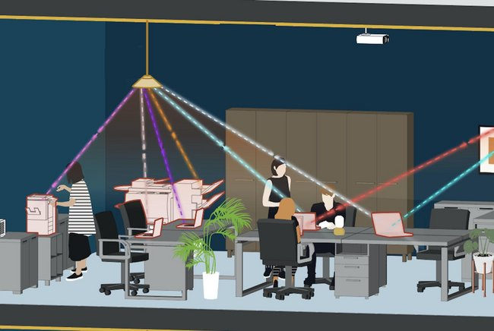
Modern Uses
• Smart remotes and home automation systems.
• IR sensors in robotics and obstacle detection.
• Thermal imaging and night- vision cameras.
Gesture-based control systems.

Slide 11
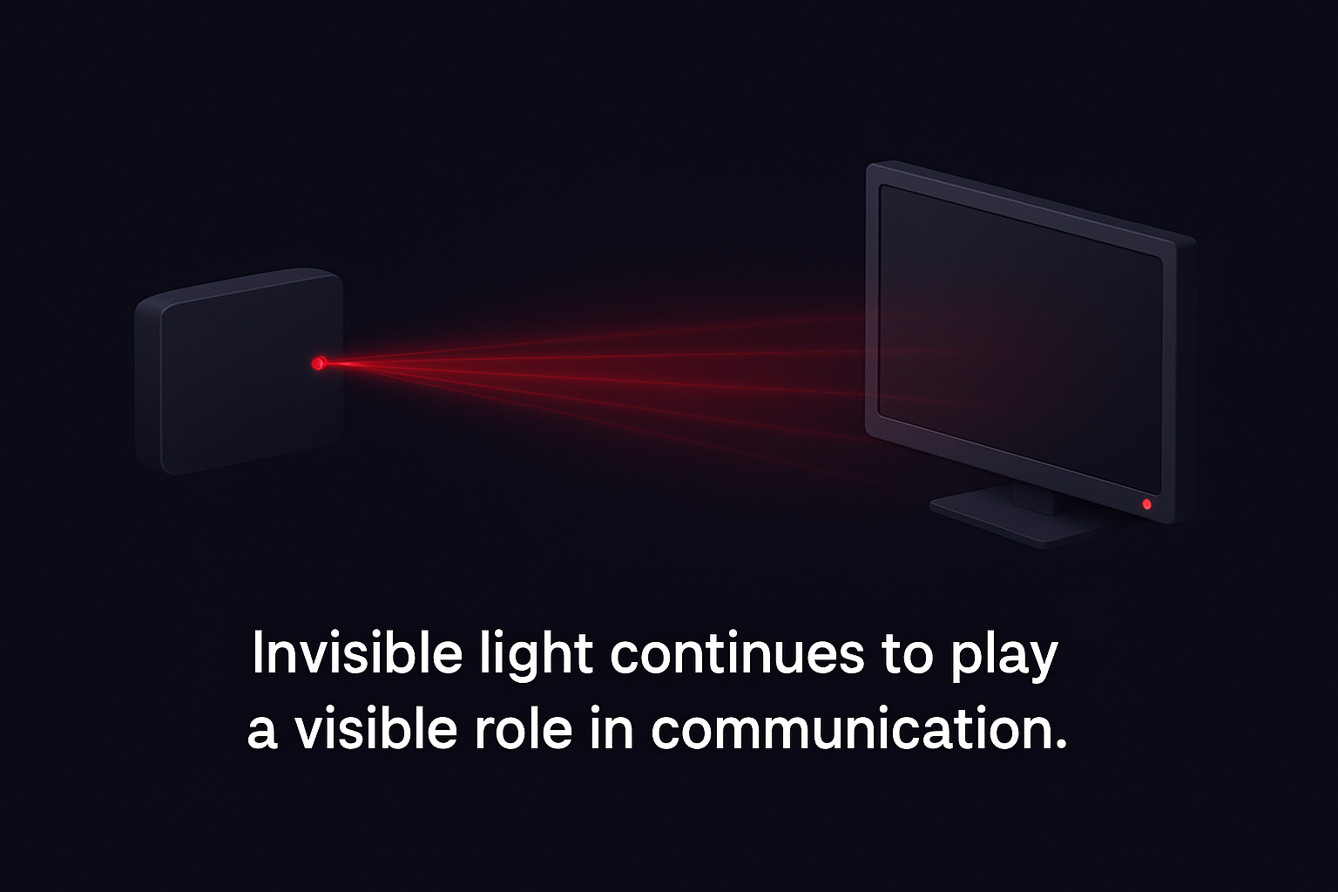
Conclusion
Infrared is a secure, simple, and low-cost short- range communication technology.
Works best for device control and sensor applications.
Though replaced by Bluetooth and Wi-Fi, it remains relevant in many embedded systems.
Invisible light continues to play a visible role in communication.

Slide 12


